Slide 1

Overview and Data Science or Science of Data
Brian Wright, PhD
brianwright@virginia.edu
Assistant Professor
Data Science Institute

Slide 2
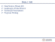
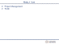
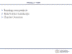
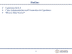

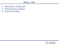
Lecture Links
Week 1
Week 2
9.2
9.4
Week 3
9.9
9.11

Slide 3
Outline
Capstones Q & A
Class Administration and Connection to Capstones
What is Data Science?

Slide 4
Class Administration/Tech Stack
Syllabus and files are on Github
https://github.com/NovaVolunteer/Practice_Application_DS
Use Collab for submission of graded material
Slack Channel:
Use for exchanging ideas, sharing interesting content or asking questions
Class is directly linked to your Capstone
Apply the content to development of the capstone project
Review Schedule and Requirements
Trello

Slide 5

Data Science Overview
What is Data Science?
X
X
X
Source: https://honingds.com/blog/intro-to-data-science/

Slide 6
Data Science Overview
Why the surge in Data Science?
Increases in Computing Power - Processor Speed/Cloud Computing
Availability of Data – Storage Capacity
Open Source Tools – Incredibly dedicated and heavily vested communities supporting technology advancement

Slide 7
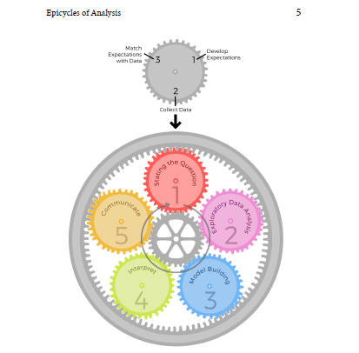
Data Science Overview
Roger Ping: Art of Data Science

Slide 8
7
6
2
5
3
4
http://sudeep.co/data-science/Understanding-the-Data-Science-Lifecycle/

Slide 9
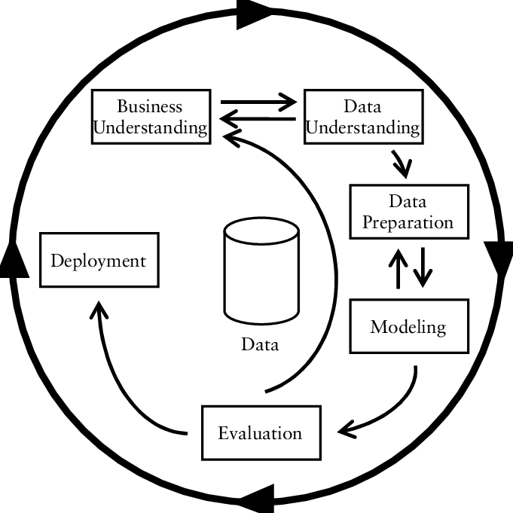
Data Science Overview
CRISP-DM
https://www.researchgate.net/figure/CRISP-DM-process-model_fig3_261307514

Slide 10

Microsoft
https://jenstirrup.com/2017/07/01/whats-wrong-with-crisp-dm-and-is-there-an-alternative/

Slide 11
Exercise: What you think? Get in Groups of Five What about these makes sense, what doesn’t and what would you draw…

Slide 12
LIFECYCLE OF THE CLASS
Question Development/Business Understanding
Project Charter
Project Proposal
Data Acquisition/Storage
Modelling Building
Data Exploration
Communications
Data Cleaning
Feature Engineering
Capstone Poster
Group Paper SEEDS
Group Presentations
Group Presentations
Final Presentations

Slide 13
Epicycle of Data Science
Setting Expectations,
Collecting information (data), comparing the data to your expectations, and if the expectations don’t match,
Revising your expectations or fixing the data so your data and your expectations match.

Slide 14
Data Science Overview
Match Expectations with Data
Develop Expectations
3
1
2
Can be the hardest, maybe not the most time consuming
Collect Data
Stating the Question

Slide 15
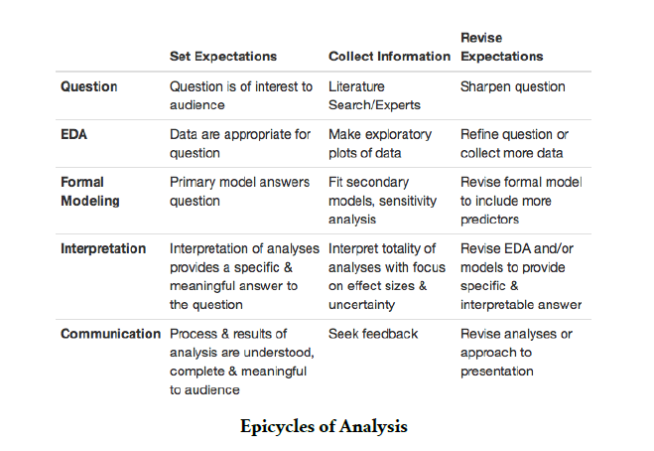
Epicycle at Each Stage

Slide 16
Research Practices Key to Question Definition/Expectations

Slide 17
Research Techniques
Create an informal Literature Review or business case review for the central topic of the issue being addressed
Subscribe to online journals or newsletters
Stay current with policy or regulatory changes in your field

Slide 18
Research Techniques
Have discussions with peers
Pull information from your previous work
Membership in professional groups
Attend conventions or training sessions

Slide 19
Research Techniques
Seek additional educational opportunities (brick and mortar or online)
Subscribe to subject specific listservs
Meet with a Librarian

Slide 20
Literature/Research Review
Gathering information on your question in a structured manner
Create an outline of sources
Reduce resources to key sources
Summarize the themes of these elements

Slide 21
Research Outcomes
Gives your recommendations and insight substance
Increases your value as a knowledge worker
Makes your organization more competitive from an intellectual capital standpoint
Allows for you to provide the maximum amount of value in your chosen field
Allows to become ever more specialized
Stay on top of the latest trends and insights
Creates a foundation for intuition and critical thinking in your chosen field

Slide 22
As a result of the ever-expanding knowledge economy and emphasis on intellectual capital driving divisions of labor resulting in hyper specialization the need to establish high quality research habits is a critical step for anyone wanting to stay competitive in his/her chosen field.

Slide 23
Week 2 – 9.04
Framing your projects
Data Science Landscape
Charter Overview

Slide 24
Exercise
Get into your capstone groups
Discuss what you think the expectation are for your project and complete the following statement:
This will be a successful project if…

Slide 25
Charter Review

Slide 26
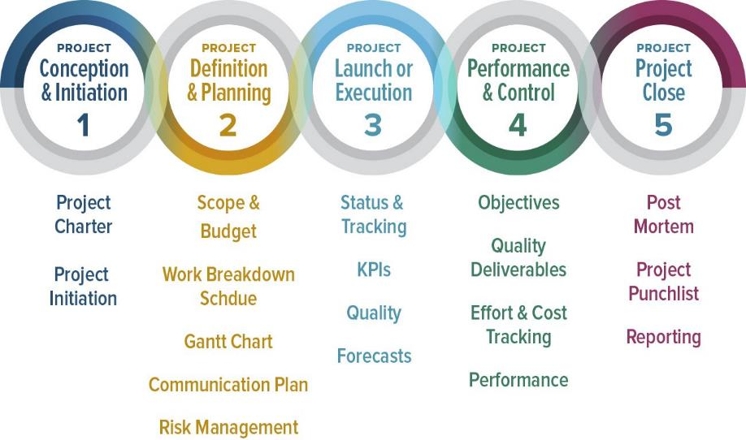
Project Management Documentation
https://www.smartsheet.com/blog/demystifying-5-phases-project-management

Slide 27
Assignment
Find a potential data science dream job, share on slack and be prepared to discuss in class on the 9th

Slide 28
Week 2 – 9.04
Data Resources: Jenn Huck
Contract Person: Bill Schoelwer
Teamwork

Slide 29
Problem Solving and Teamwork

Slide 30
General Problem Solving Hints
There may be more than one right answer (or none at all)
There may be more than one path to the right answer
Use the right tool for the job
Use approximations
Don’t let yourself get stuck
Try thinking of something completely different

Slide 31
Specific Problem Solving Strategies
Draw a picture
Make a table
Graph the data
Re-organize the information
Solve a simplified version of the problem
Use logic or approximations to do a “gut-check” against your answers

Slide 32
The Four Questions Problem Solving
What do I know?
What am I looking for?
What else do I need to find it?
What do I expect?

Slide 33
Answer the Four Questions
American Pharaoh won the Triple Crown. He won the Belmont, a 12 furlong track, with a time of 2:26.65, the Kentucky Derby, a 10 furlong track, with a time of 2:03.02, and the Preakness Stakes, a 9.5 furlong track, with a time of 1.58.46. What was his average speed in mph?

Slide 34
Now Solve the Problem
Work in your Capstone Teams to code the solution with an output that reads “[Horse’s Name] averaged [ x ] mph across the three triple crown races.
American Pharaoh won the Triple Crown. He won the Belmont, a 12 furlong track, with a time of 2:26.65, the Kentucky Derby, a 10 furlong track, with a time of 2:03.02, and the Preakness Stakes, a 9.5 furlong track, with a time of 1.58.46. What was his average speed in mph?

Slide 35
Week 3 - 9.09
Data Science Dream Job
Landscape of Data Science
Technical Presentations
Proposal Writing

Slide 36
Dream Job
Who wants to share?
What trends did you notice?
What kind of jobs seemed the most appealing?
What kind of jobs did you like the least?
Do we think jobs will become more specialized over time?
https://github.com/JasonYao/NLP-twitter-stock-trader/blob/master/README.md

Slide 37
Landscape of Data Science

Slide 38
Types of Data Scientists
Those strong in statistics: they sometimes develop new statistical theories for big data, that even traditional statisticians are not aware of. They are expert in statistical modeling, experimental design, sampling, clustering, data reduction, confidence intervals, testing, modeling, predictive modeling and other related techniques.
Those strong in mathematics: NSA (national security agency) or defense/military people working on big data, astronomers, and operations research people doing analytic business optimization (inventory management and forecasting, pricing optimization, supply chain, quality control, yield optimization) as they collect, analyses and extract value out of data.
Those strong in data engineering, Hadoop, database/memory/file systems optimization and architecture, API's, Analytics as a Service, optimization of data flows, data plumbing.

Slide 39
Types of Data Scientists
Those strong in machine learning / computer science (algorithms, computational complexity)
Those strong in business, ROI optimization, decision sciences, involved in some of the tasks traditionally performed by business analysts in bigger companies (dashboards design, metric mix selection and metric definitions, ROI optimization, high-level database design)
Those strong in production code development, software engineering (they know a few programming languages)
Those strong in visualization
Those strong in GIS, spatial data, data modeled by graphs, graph databases
Those strong in a few of the above.

Slide 40
Fields of Focus
Biotech (Genome)
Finance (Time-Series/Forecasting)
Health Care (Survival Analysis/Fraud Detection)
Cyber Security (Defense Against Attacks)
Geospatial Analysis (Climate Change/Earthquakes/Intelligence)
What else….

Slide 41
Fields of Focus
Do we think jobs will
https://github.com/JasonYao/NLP-twitter-stock-trader/blob/master/README.md

Slide 42
Data Science Overview
What do Data Scientists actually do anyway?
https://www.kaggle.com/surveys/2017

Slide 43
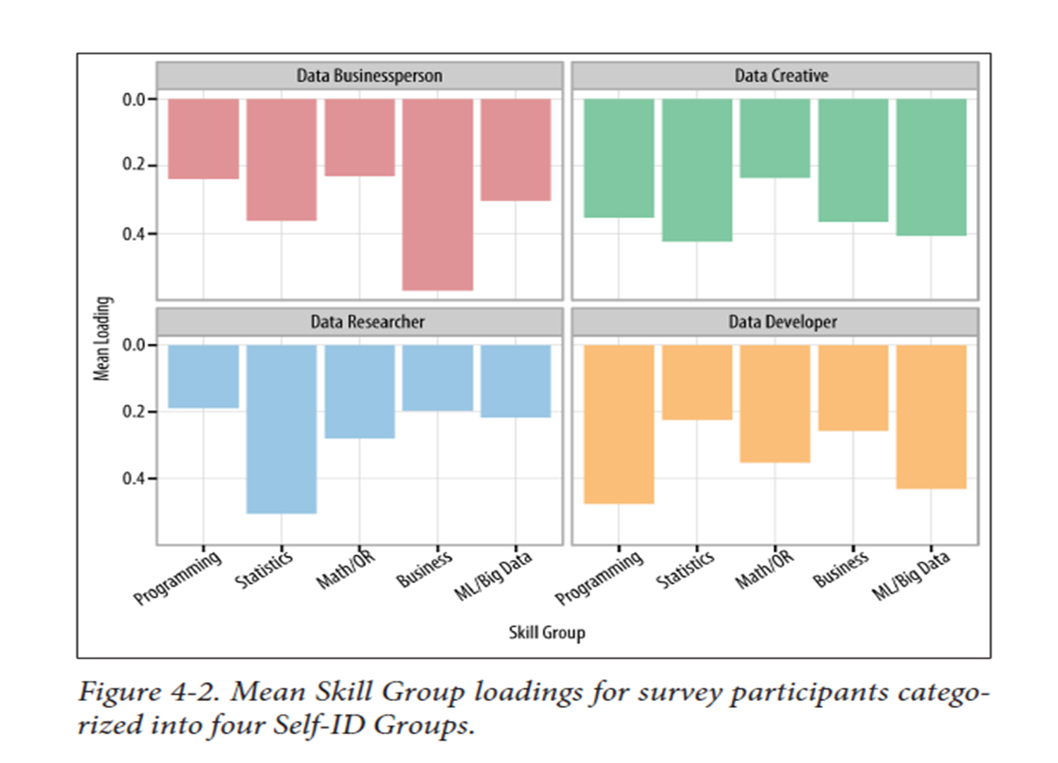

Slide 44
Be thinking about what type of Data Scientists you are/or want to be and what field of specialty in which you would like to work.
http://survey.datacommunitydc.org/reset

Slide 45
Importance of Data Science Communications
Business Broadway surveyed over a 1,000 data scientists across a variety of domains to determine the top 10 skills for different data science roles: Roles:
Business Manager
Developer
Creatives
Researcher
Where do you think communications falls for Developer and Reseacher?
Poll…next slide

Slide 46
Quick Poll
Join at
slido.com
#Y676
Notes:
https://admin.sli.do/event/pm3yh3cy/polls

Slide 47
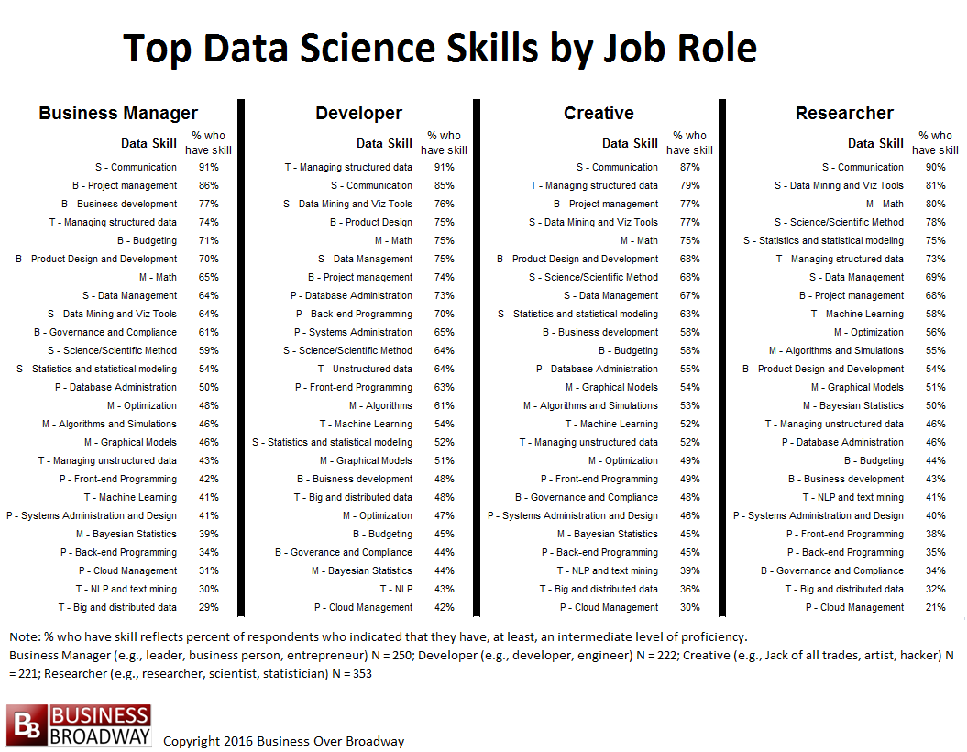

Slide 48
Key Points
Data visualization can be seen as the product data science professionals are generating prior to deployment
Communications just as important as technical skills across a variety of data science focus areas

Slide 49
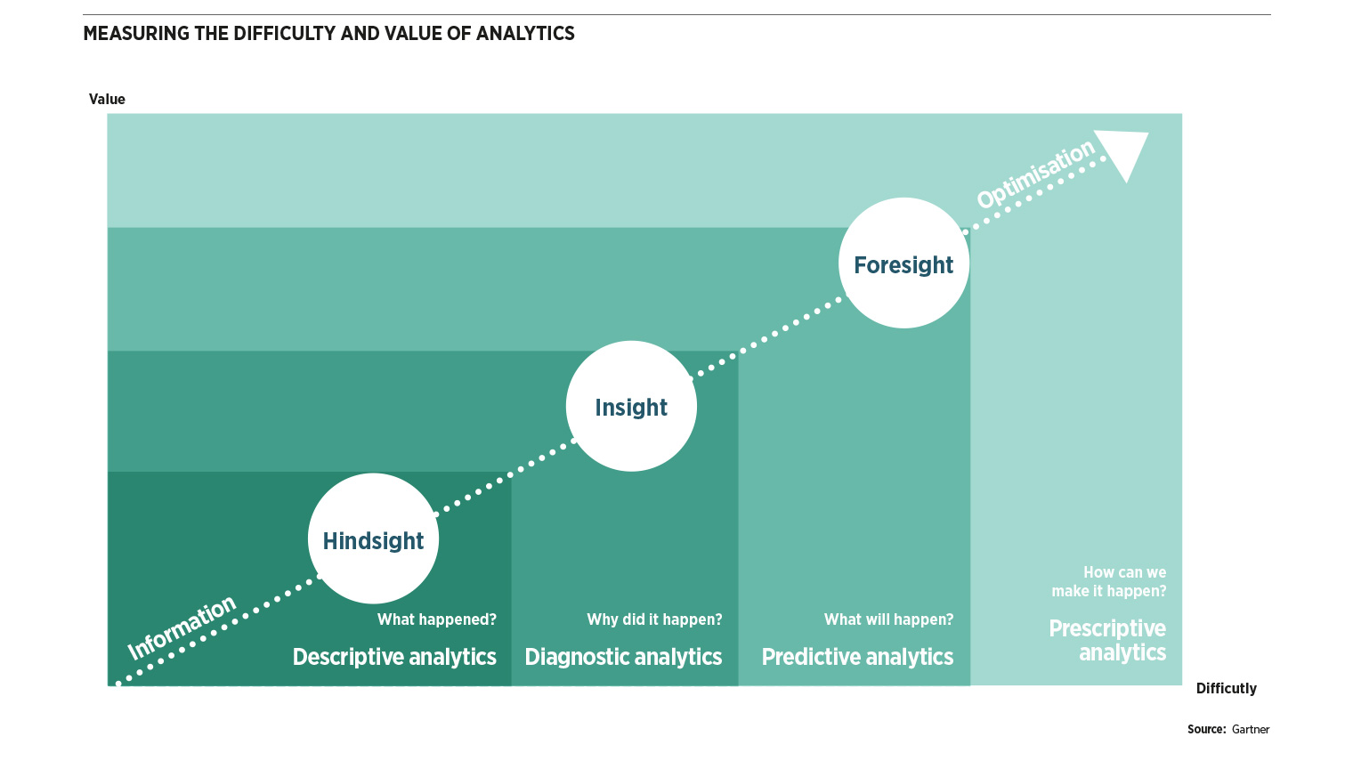
Data Science Overview: Data Analytics (Science) Levels
X
Cumulative Effect
X
Knowledge Requirement

Slide 50
Week 3 - 9.11
Technical Presentations
Proposal Writing

Slide 51
Technical/Proposal Presentations
Elements of Your Presentation:
Title Slide
Problem and Motivation
Background/Previous Work
Data Overview (if you know)
Potential Solution – Models/Analysis
Final Product/Expected Outcome – (Dev Ops)
10 slides or less/6 to 8-minute presentations

Slide 52
Technical/Proposal Presentations
Tips:
No Code
Think of the presentation as a story: each slide should contribute to the story and there should be an arch

Slide 53
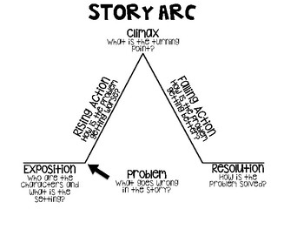
Technical/Proposal Presentations
Sketch out the presentation before you build it using this format
https://www.teacherspayteachers.com/Browse/Search:arc%20of%20the%20story%20graphic%20organizer

Slide 54

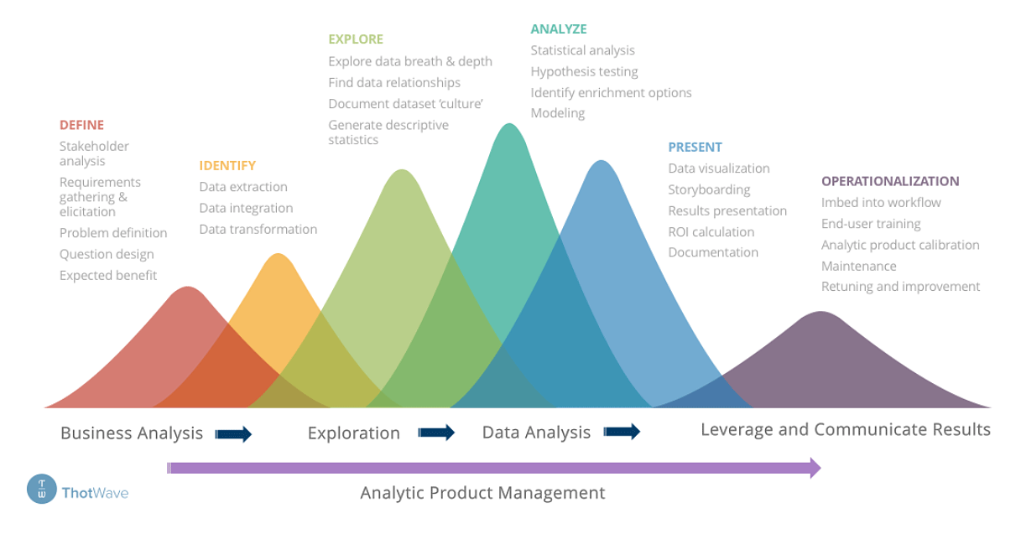
Technical/Proposal Presentations: Use Lifecycle as Arch
7
6
2
5
3
4

Slide 55
Technical/Proposal Presentations
Tips:
Don’t include a graphic if it adds no value
No graphic for graphics sake!
Keep slides simple
Be ready for detail question, include speaker notes if needed for ease of reference
Slides should frame your conversation not be the conversation
Don’t just read the slides
Make text readable from the back of the room

Slide 56
Technical/Proposal Presentations
Tips:
Speak slowly
Make eye contact with the audience
Use a pointer and slide clicker as needed
Practice with your team

Slide 57
Proposal Writing

Slide 58
Proposal Writing
Good proposal stems from a good concept. The best proposals are those to which the reviewers respond, “Of course, I wish I had thought of that!” – National Science Foundation, Directorate for Education and Human Resources.

Slide 59
Technical/Proposal Presentations
Problem Statement Definition
Background Research
Writing Assignments and Milestones
Budget preparation and Approval
Schedule preparation and Approvals

Slide 60
Technical/Proposal Presentations
Review Outline

Slide 61
Week 3 - 9.11
Project Management
Trello

